Slide 1
BOOK SHOP

Slide 2
AIM OF THE PROJECT
A Book Shop management is a project that manages and stores book information according to shopkeeper’s needs.
It allows the book shop owner to search for the desired book.
A Shopkeeper can add or remove the books he/she wants from the database.

Slide 3
SOFTWARE AND HARDWARE REQUIREMENTS
HARDWARE REQUIREMENTS
Processor : intel i5
RAM : 8 gb
HARD DISK DRIVE : 500 gb
SOFTWARE REQUIREMENTS
Front End : Java Swing
Back End : MySQL, JAVA

Slide 4
PROPOSED SYSTEM
Proposed System is am Book Shopping System. Through our software
an admin can add, update , delete and search books.
User friendly interface.
Easy access to database.
Search facility.
More Storage.

Slide 5
MODULE LIST
SAVE
EXIT
CLEAR
UPDATE
DELETE
SEARCH

Slide 6
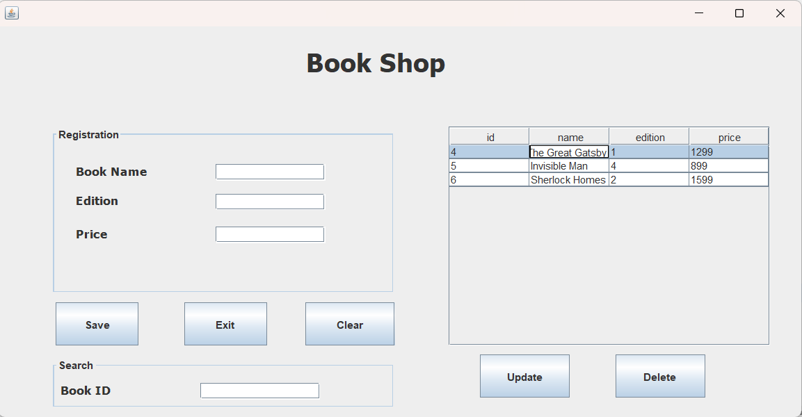
HOME SCREEN

Slide 7
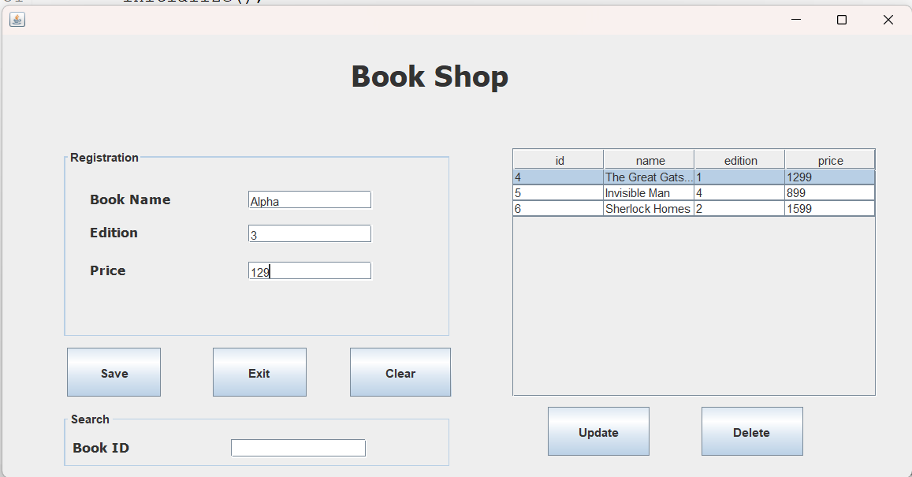
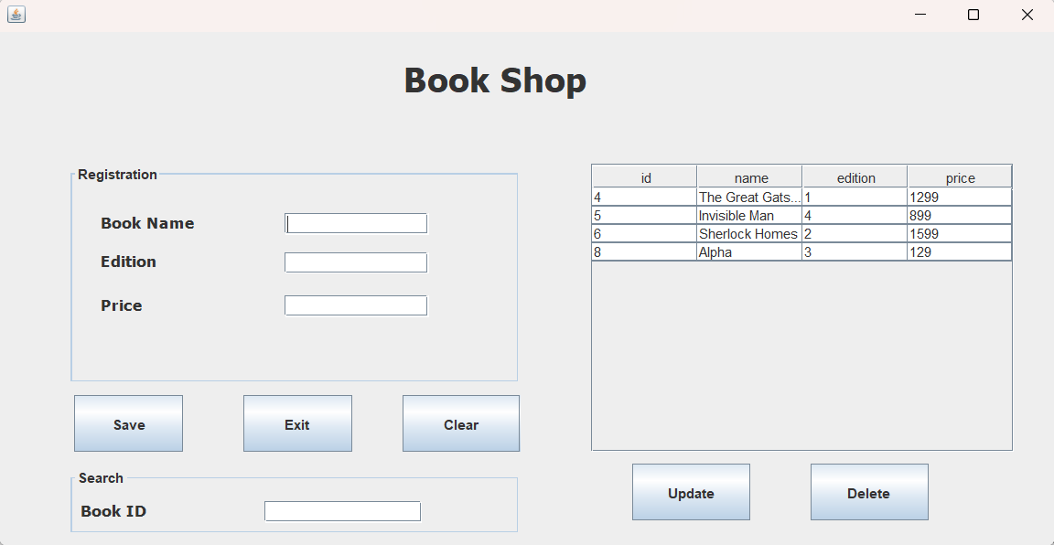
ADDING A RECORD

Slide 8
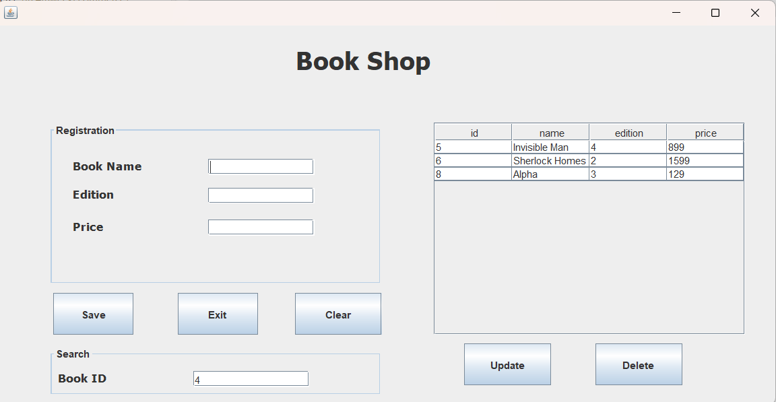
DELETING A RECORD

Slide 9
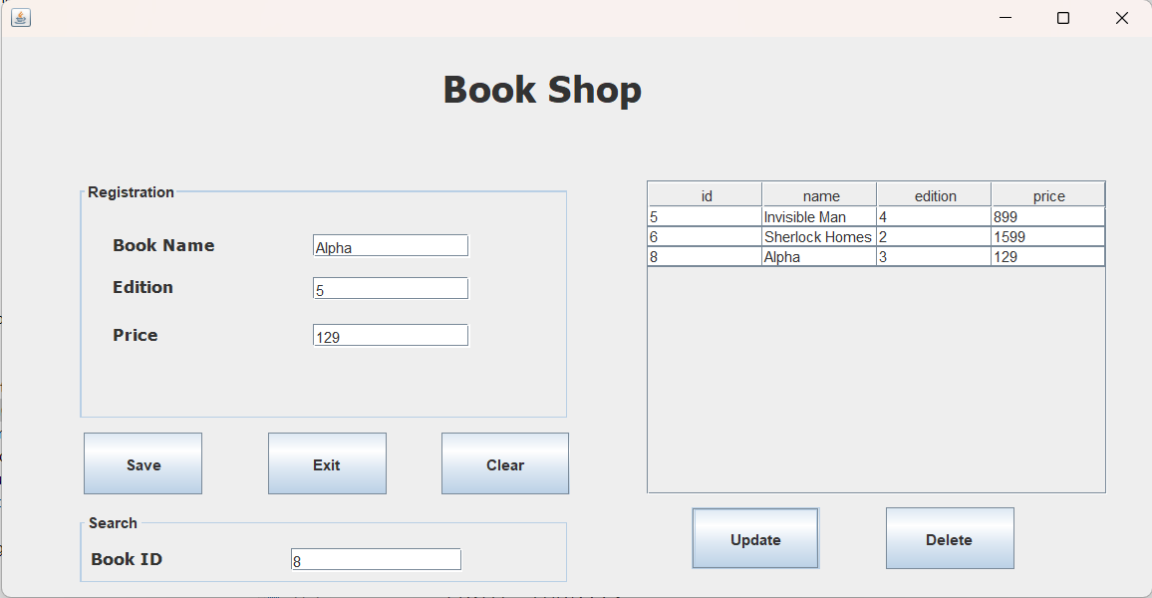

UPDATING A RECORD

Slide 10
THANK YOU

